Slide 1
Genus 2: Penicillium
It is so called green molds and blue molds. We so frequently find on citrus and other fruits, on cheeses in the refrigerator, and other food stuffs. The conidia of Penicillium, like those of Aspergillus, are everywhere in the air and in the soil. In the biological Lab, they are as frequent contaminants as Aspergillus and Rhiozpus.

Slide 2
Various species of Penicillium attack and destroy fruits; P. italicum and P. digitatum are common pathogens of citrus and fruits causing blue mold and green mold respectively. P. expansum causes a decay of apples in storage. P. notatum or P. chrysogenum was used for penicillin production, and P. griseofulvum was used for griseofulvin production, which is the best antibiotic effective in control of fungal skin diseases (Dermatomycoses), such as athlete s foot. The sexual stage of Penicillium is called Talaromyces.

Slide 3
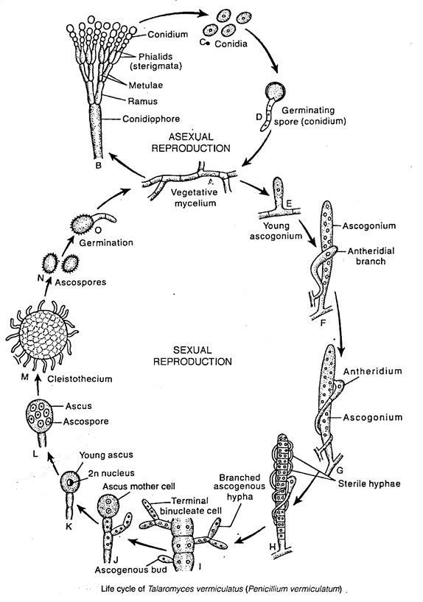

Slide 4
Family2 : Gymnoascaceae
Fungi that includes the ascomycetous state of many of the dermatophytes and several of the systemic pathogens for humans :Histoplasma capsulatum , Blastomyces dermatidis, Nannizzia (Microsporum), Blastomyces, Arthroderma (Trichophyton).Until the sexual forms were recognized, these pathogens were
classified with Imperfect Fungi

Slide 5
Nannizzia (Microsporum): Usually devoid of conidia (macro- or microconidia). Septate hyphae with terminal chlamydoconidia, often pointed at the end. Macroconidia are often irregular or non-uniform in shape. Colonies on culture media are flat, silky in appearance. Growth of colonies on culture media is tight. On reverse of colony - pigment is reddish-brown in color.

Slide 6
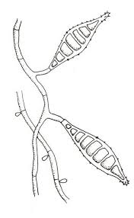
Arthroderma(Trichophyton) : The word "trichophyton" literally means "hair plant". Presence of macroconidia in cultures varies and may not help in identification of cultures. Microconidia shape and presence varies. Microconidia are globose (round-shaped), pyriforme (pear-shaped), or clavate (club-shaped). Most common species include:
Trichophyton mentagrophytes , T. rubrum , T. tonsurans and T. verrucosum.

